Slide 1

An introduction to explainable artificial intelligence with LIME and SHAP
Aleix Nieto Juscafresa
Treball Final de Grau
Universitat de Barcelona
GRAU DE MATEMÀTIQUES
Dirigit per Dr. Albert Clapés i Dr. Sergio Escalera
29 de juny de 2022
Notes:
1 - Welcome to my final year project presentation.
2 – I am Aleix Nieto Juscafresa and the title of the Project is “An introduction to explainable artificial intelligence with LIME and SHAP”.
3 – I have been supervised by Dr. Albert Clapés & Dr. Sergio Escalera.

Slide 2


Contents
Introduction
Machine learning
Random forest
Regression
Explainable artificial intelligence
Conclusions
Notes:
1 - First, let’s begin with the contents of the Project, which starts with an introduction.
2- Secondly I am going to explain….
3- then 3 & 4
4- In the fifth and the cornerstone section of the Project I introduce ….
5- Finallly a conclusion….

Slide 3




Introduction Machine learning Random forest Regression Explainable artificial intelligence Conclusions
Introduction
Today
Confusion with Today’s AI Black Box
Data
Black-box model
Prediction
?
Why did you do that?
Why did you not do that?
When do you succed or fail?
How do I correct an error?
Decision
Explainable AI
(XAI)
Explainable AI
Clear & Transparent Decisions
Data
Black-box model
Prediction
I understand why
I understand why not
I know why you suceed or fail
I understand, I trust you more
Decision
Explanation
Notes:
1 – Users asked to trust … critical areas… model said so.
2 – Nowadays, most powerful ML models are hardly interpretable → black box
3 – Understanding the reasoning behind …. Motivated the Project.
4 – XAI

Slide 4
Contents
Introduction
Machine learning
Random forest
Regression
Explainable artificial intelligence
Conclusions
Notes:
1 - First, let’s begin with the contents of the Project, which starts with an introduction.
2- Secondly I am going to explain….
3- then 3 & 4
4- In the fifth and the cornerstone section of the Project I introduce ….
5- Finallly a conclusion….

Slide 5
Introduction Machine learning Random forest Regression Explainable artificial intelligence Conclusions
Machine learning
Application of artificial intelligence dedicated to the creation of algorithms that allow systems to learn without human intervention.
Machine learning
SUPERVISED LEARNING
UNSUPERVISED LEARNING
SEMI-SUPERVISED LEARNING
REINFORCEMENT LEARNING
…

Slide 6
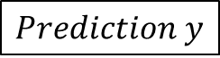
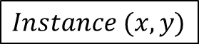

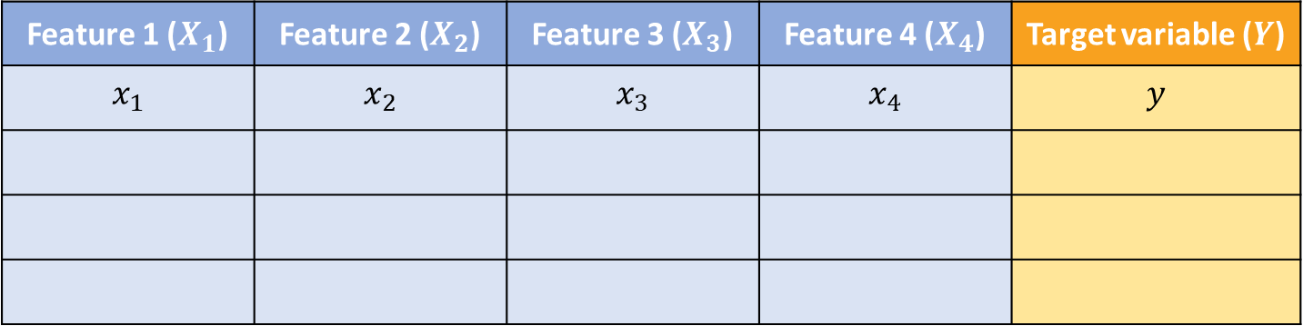
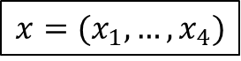

Introduction Machine learning Random forest Regression Explainable artificial intelligence Conclusions
Terminology
$$X$$
Feature 1 ($X_{1}$) | Feature 2 ($X_{2}$) | Feature 3 ($X_{3}$) | Feature 4 ($X_{4}$) | Target variable ($Y$)
$$x_{1}$$ | $$x_{2}$$ | $$x_{3}$$ | $$x_{4}$$ | $$y$$
$$x=(x_{1},…,x_{4})$$
$$Dataframe$$
$Instance$ $(x, y)$
$$Age = 56$$ | $$Gender = F$$ | $$BMI = 30$$ | $$Stroke = yes$$ | $$Diabetic=yes$$
$Prediction$ $y$

Slide 7
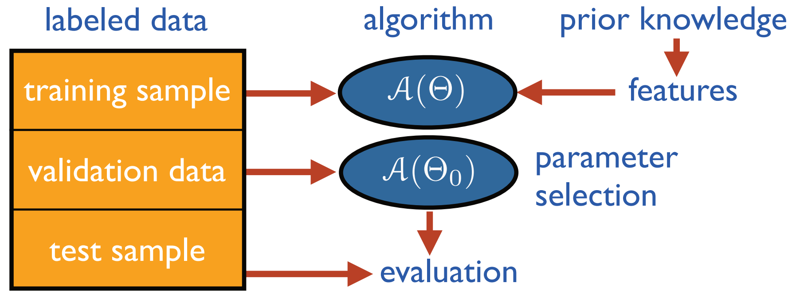

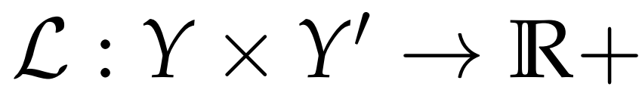
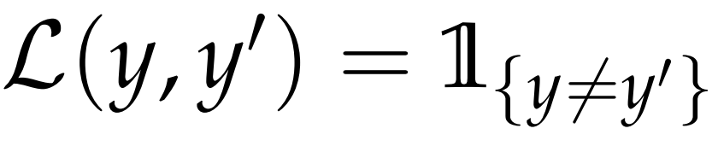
Introduction Machine learning Random forest Regression Explainable artificial intelligence Conclusions
Machine learning model learning stages
Loss function
hyperparameter
tuning
evaluation
evaluation
Cross validation

Slide 8
Contents
Introduction
Machine learning
Random forest
Regression
Explainable artificial intelligence
Conclusions
Notes:
1 - First, let’s begin with the contents of the Project, which starts with an introduction.
2- Secondly I am going to explain….
3- then 3 & 4
4- In the fifth and the cornerstone section of the Project I introduce ….
5- Finallly a conclusion….

Slide 9
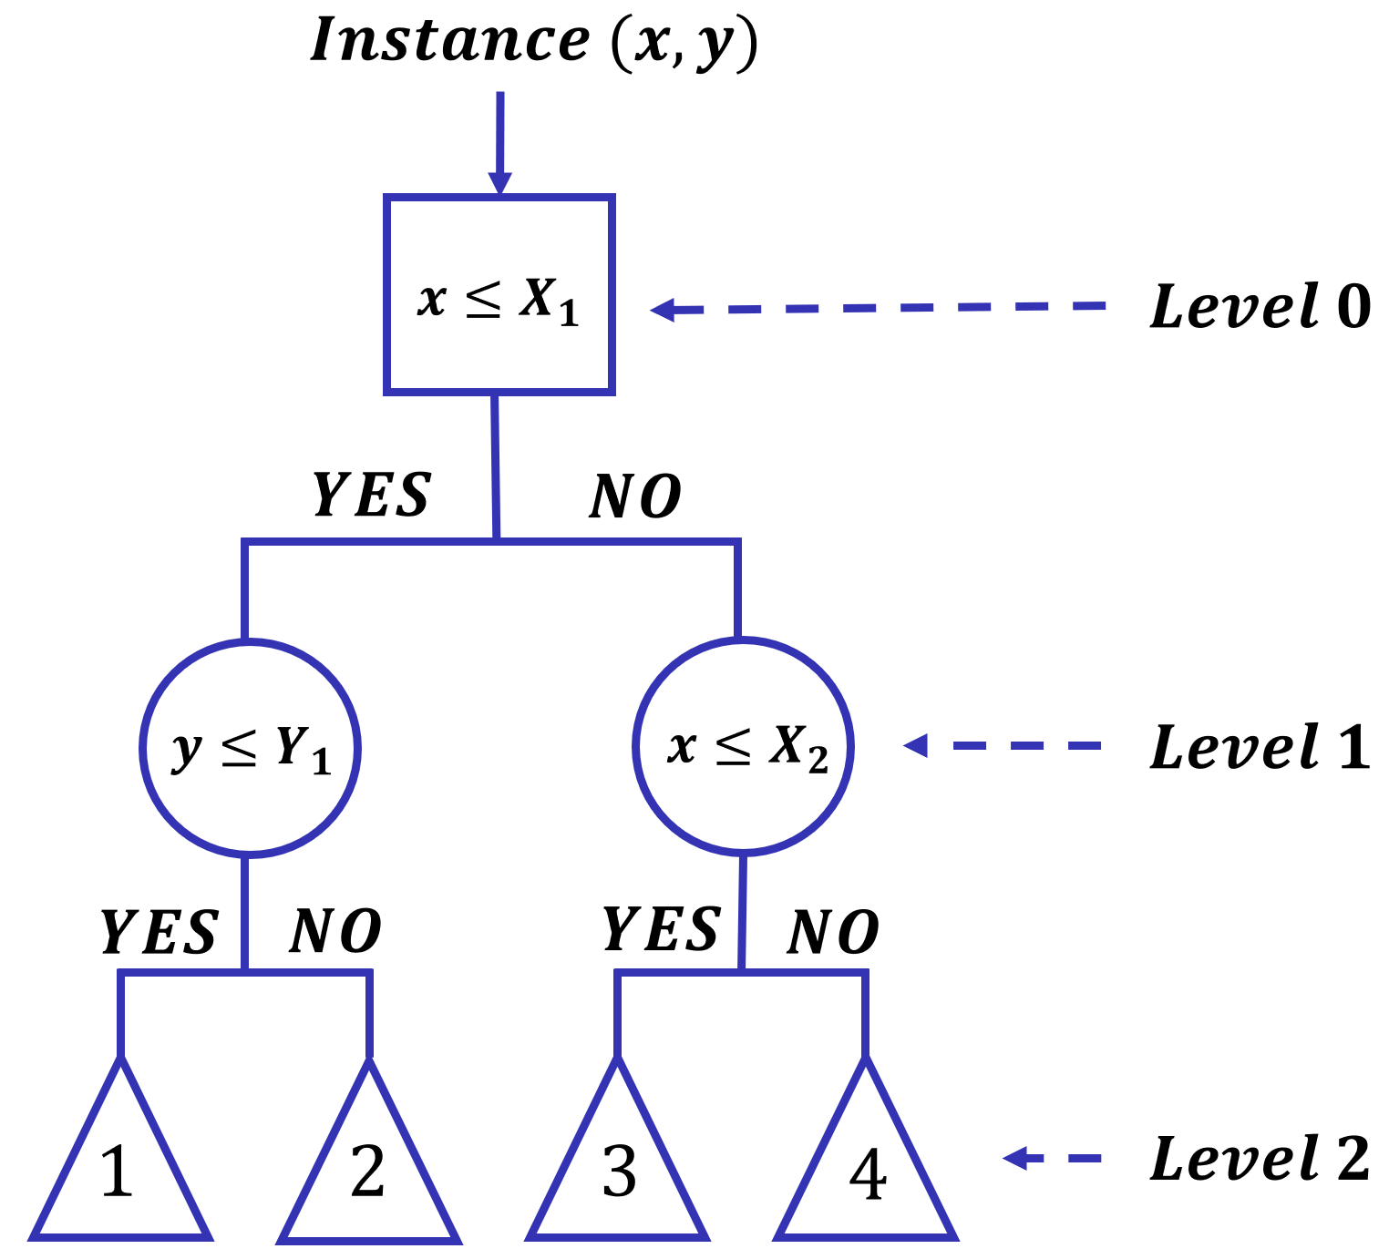
Introduction Machine learning Random forest Regression Explainable artificial intelligence Conclusions
Decision tree
Notes:
COMENTAR en què els millora el random forest

Slide 10
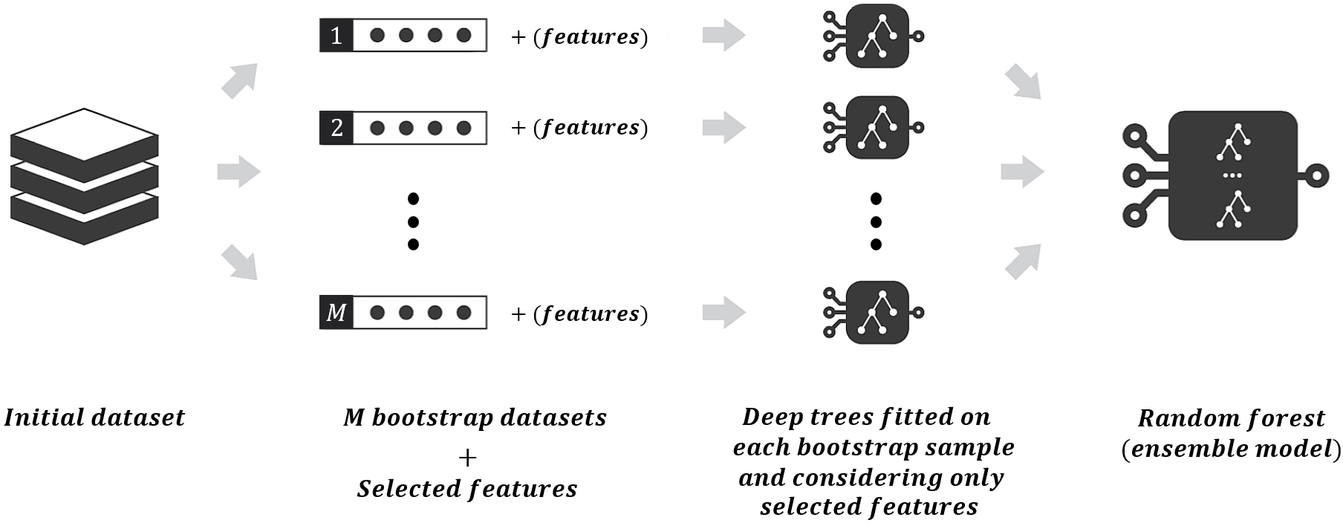
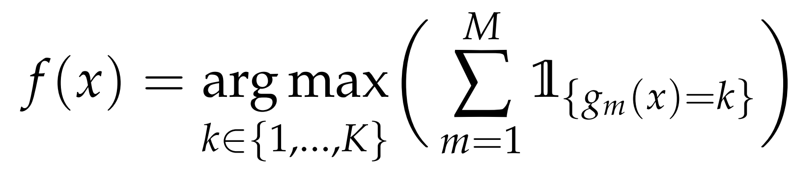
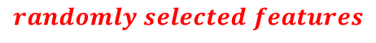
Introduction Machine learning Random forest Regression Explainable artificial intelligence Conclusions
Random forest
$$randomly selected features$$

Slide 11
Contents
Introduction
Machine learning
Random forest
Regression
Explainable artificial intelligence
Conclusions
Notes:
1 - First, let’s begin with the contents of the Project, which starts with an introduction.
2- Secondly I am going to explain….
3- then 3 & 4
4- In the fifth and the cornerstone section of the Project I introduce ….
5- Finallly a conclusion….

Slide 12
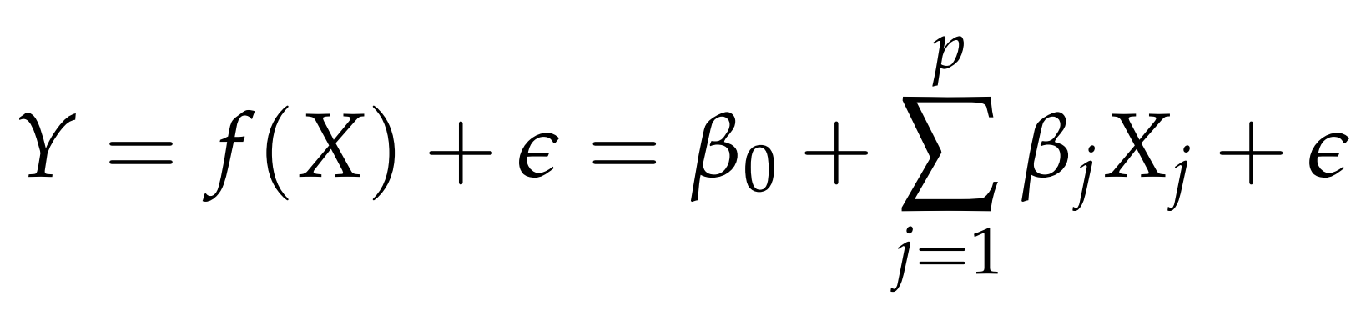
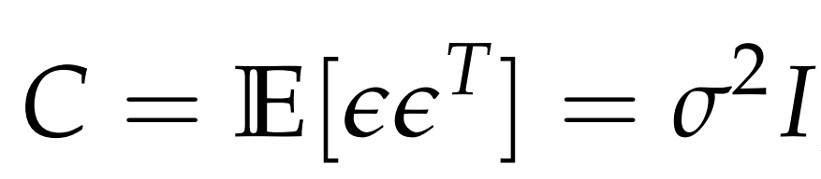
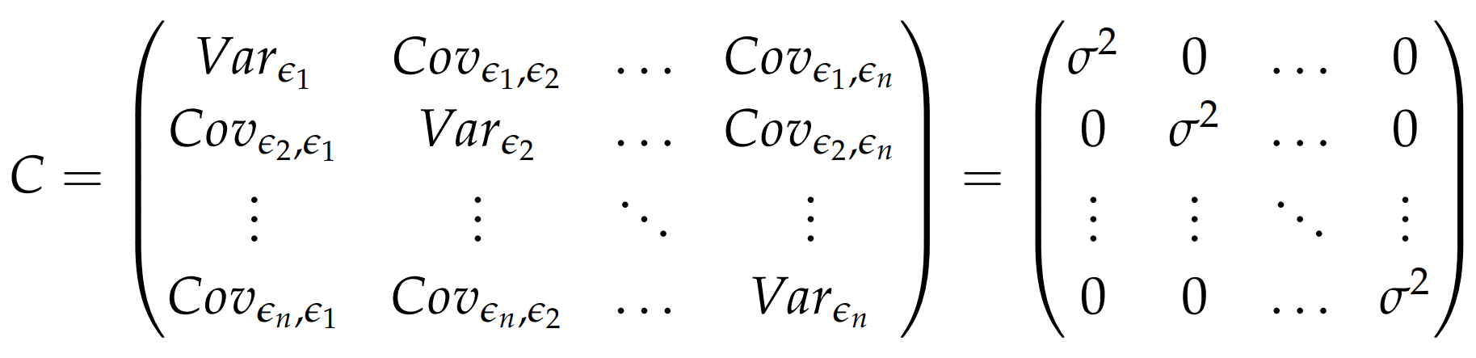
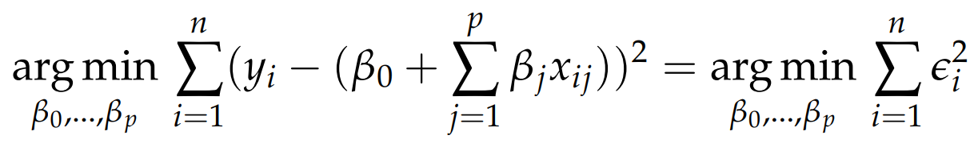
Introduction Machine learning Random forest Regression Explainable artificial intelligence Conclusions
Linear regression
Optimisation problem
Linearity
Normality
Independence
Absence of multicollinearity
Fixed features
Homoscedasticity
Model assumptions

Slide 13
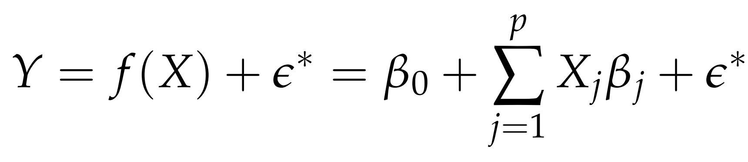
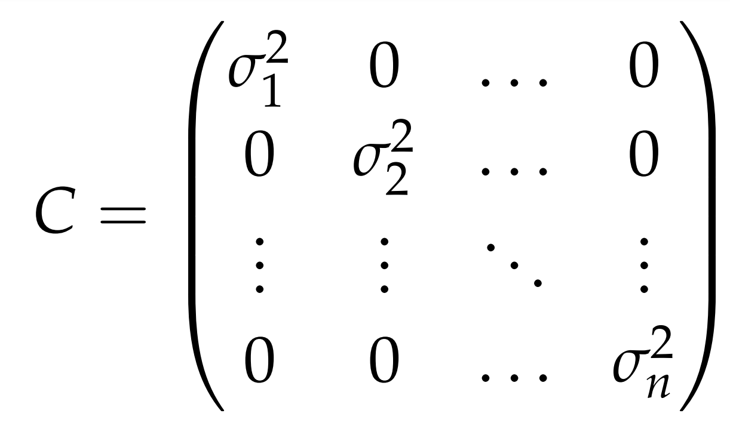
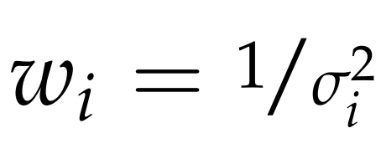
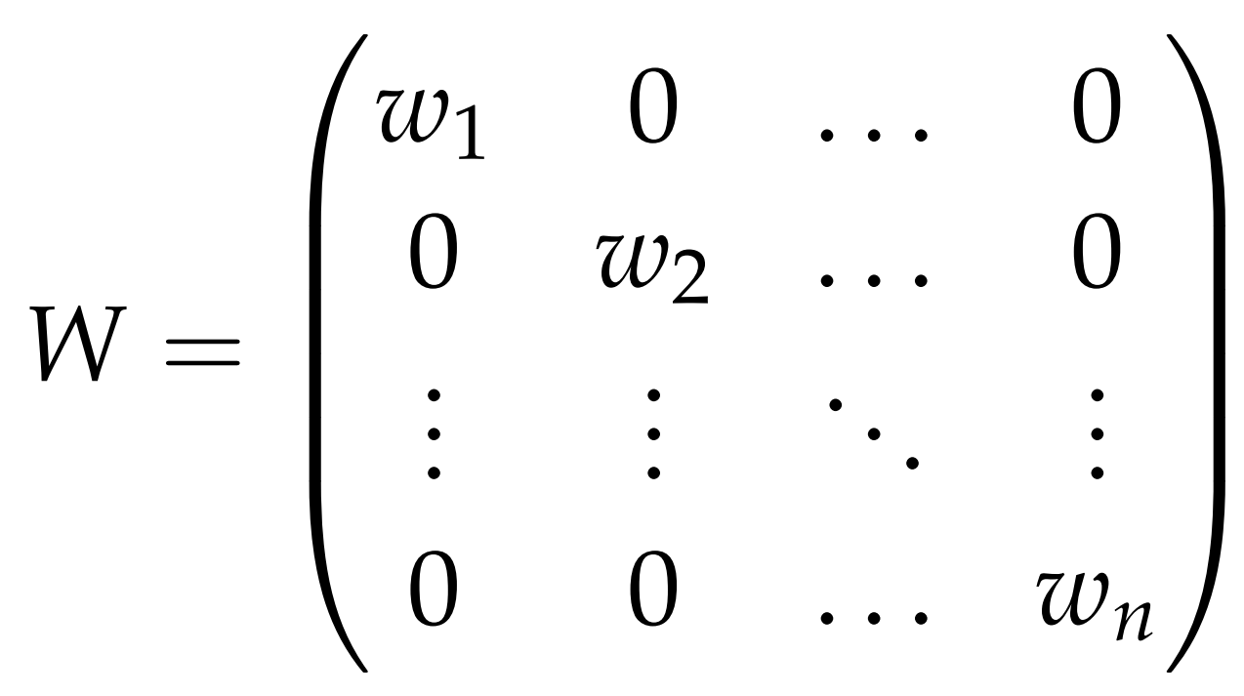
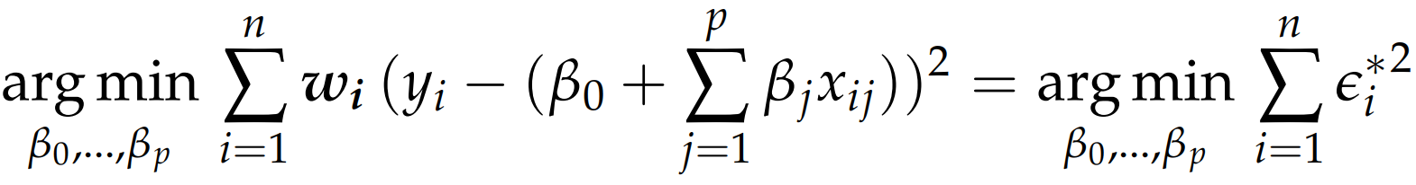
Introduction Machine learning Random forest Regression Explainable artificial intelligence Conclusions
Weighted linear regression
Optimisation problem
W
Weighted linear regression uses different weights for each observation based on their variance. A small error variance observation has a large weight since it includes more information than a large error variance observation, which has a small weight.
Violation of homoscedasticity

Slide 14
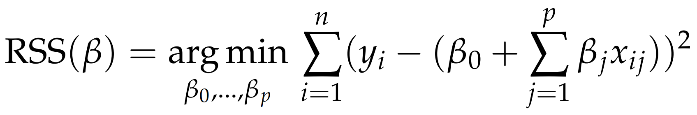
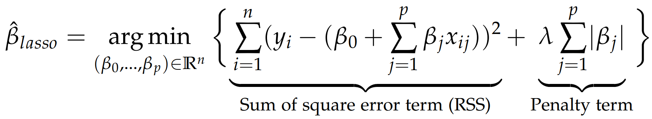
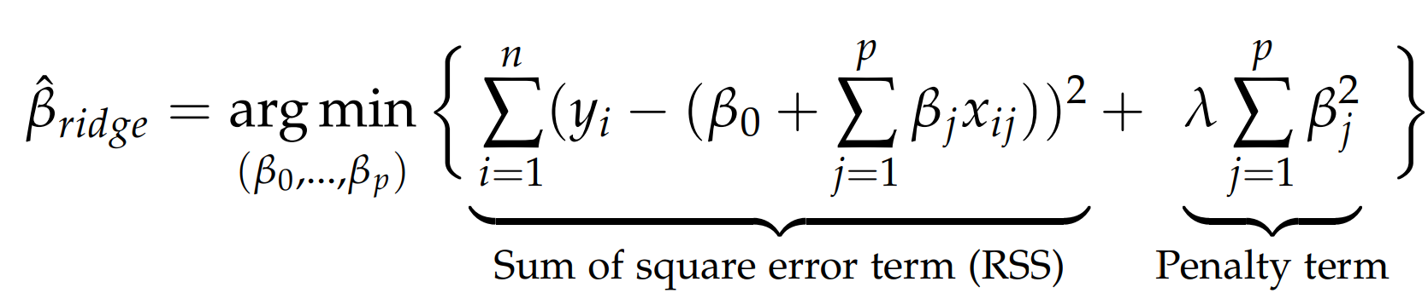
Introduction Machine learning Random forest Regression Explainable artificial intelligence Conclusions
L1 and L2 regularisation
Lasso regression (L1 regularisation)
Ridge regression (L2 regularisation)
It tends far more to drive small weights to 0.
It pushes down big weights than tiny ones.

Slide 15
Contents
Introduction
Machine learning
Random forest
Regression
Explainable artificial intelligence
Conclusions
Notes:
1 - First, let’s begin with the contents of the Project, which starts with an introduction.
2- Secondly I am going to explain….
3- then 3 & 4
4- In the fifth and the cornerstone section of the Project I introduce ….
5- Finallly a conclusion….

Slide 16
Introduction Machine learning Random forest Regression Explainable artificial intelligence Conclusions
What is explainable AI?
Explainable artificial intelligence
Set of techniques that either produce more understandable models keeping high levels of performance or provide external tools to better understand the models that are inherently not interpretable.

Slide 17
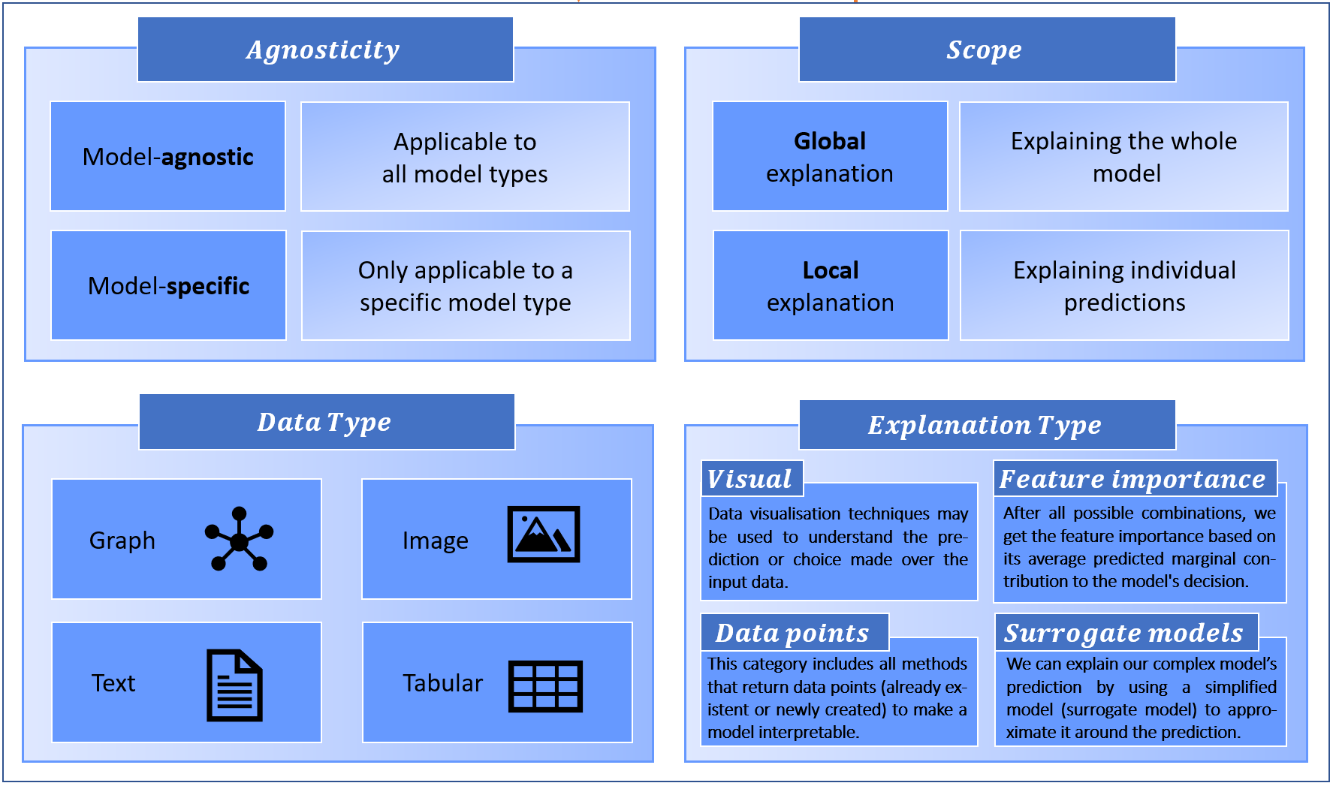
Introduction Machine learning Random forest Regression Explainable artificial intelligence Conclusions
XAI taxonomy

Slide 18
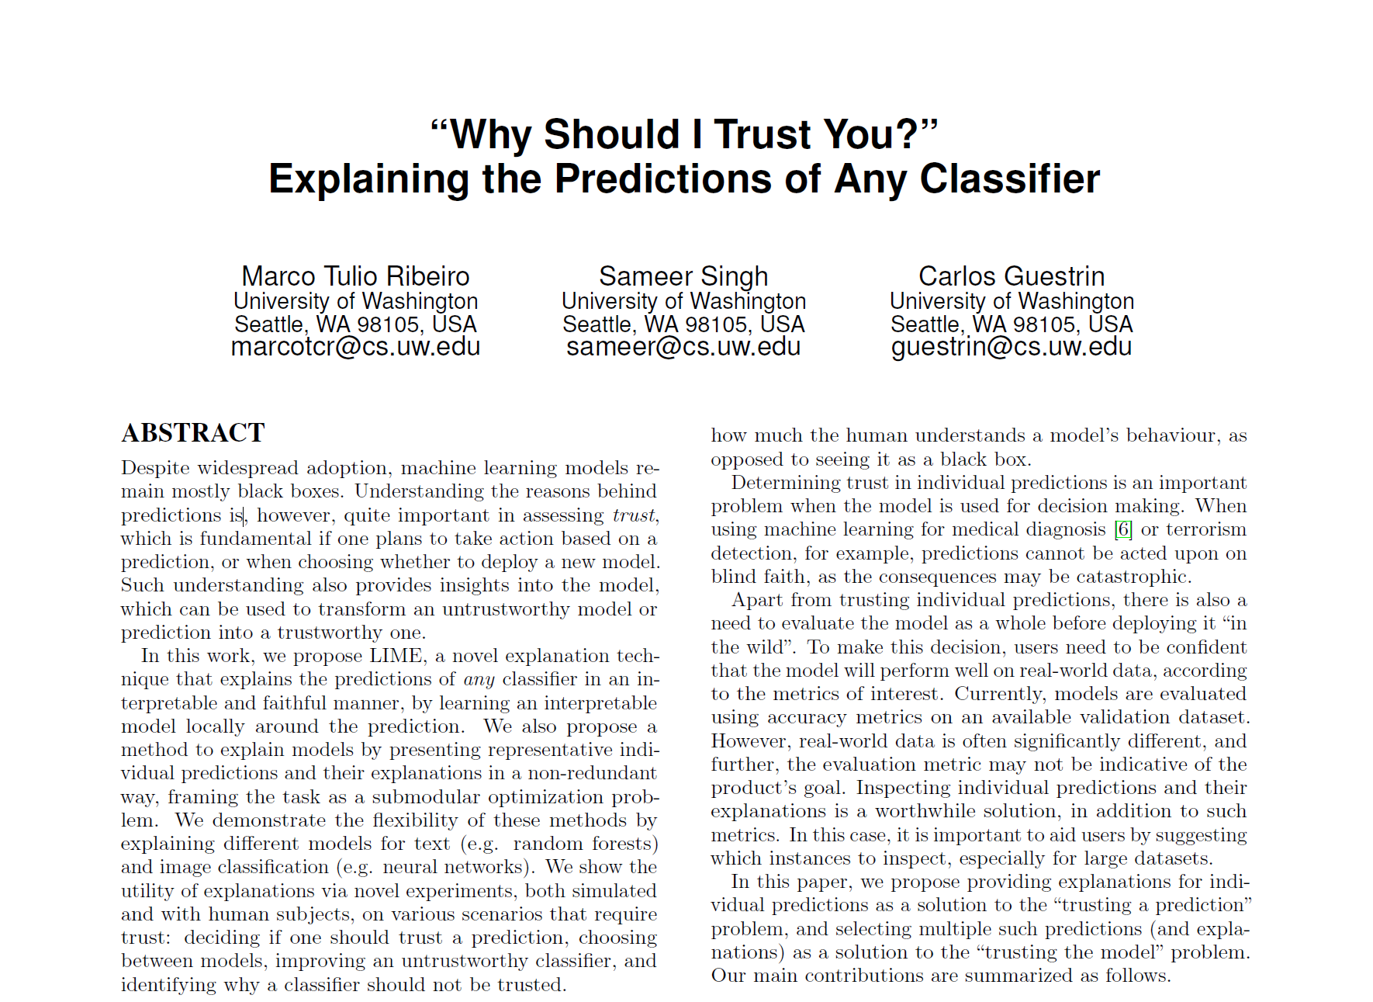
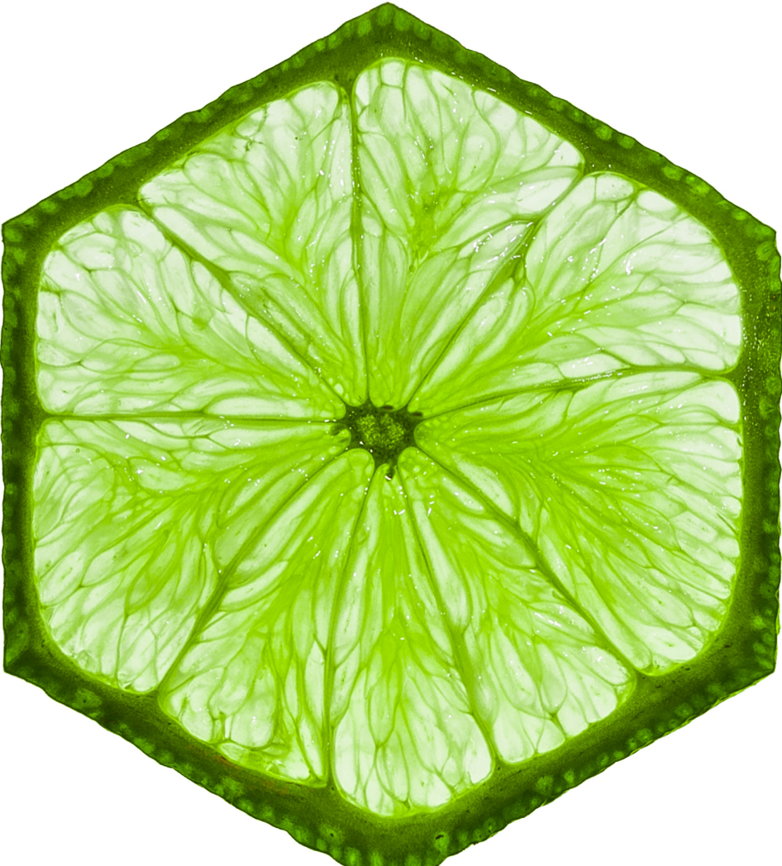
Introduction Machine learning Random forest Regression Explainable artificial intelligence Conclusions
LIME
Local
Interpretable
Model-agnostic
Explanations

Slide 19
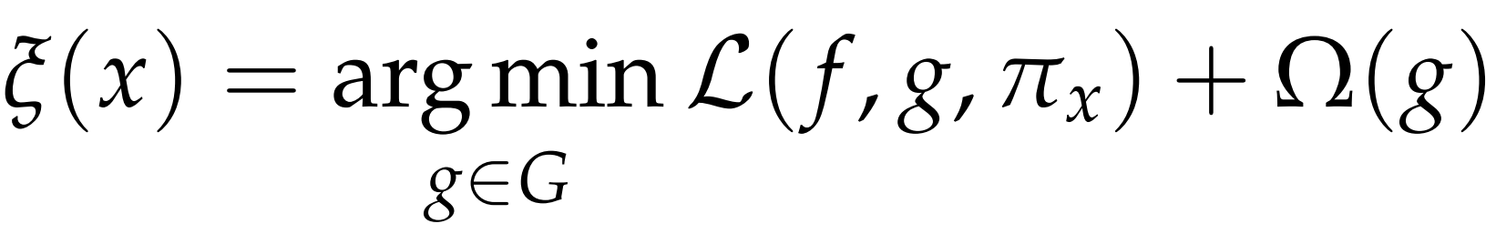
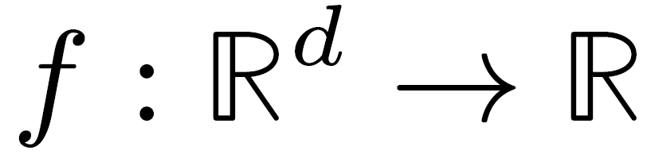

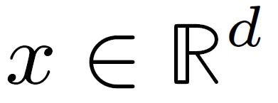
Introduction Machine learning Random forest Regression Explainable artificial intelligence Conclusions
LIME optimisation problem
(1)
(2)
Complex model
Neighbourhood of x
Family of
interpretable
models
Simple
interpretable
model
number of features
2 LOSS TERMS
$$Age = 56$$ | $$Gender = F$$ | $$BMI = 30$$ | $$Stroke = yes$$

Slide 20
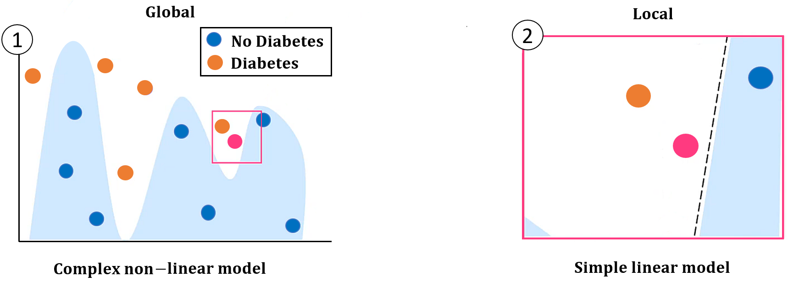
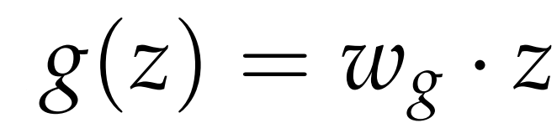
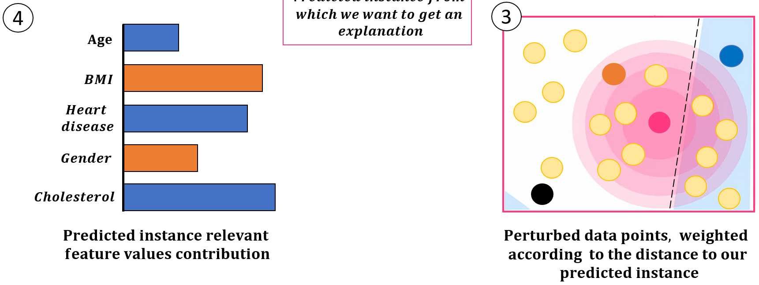
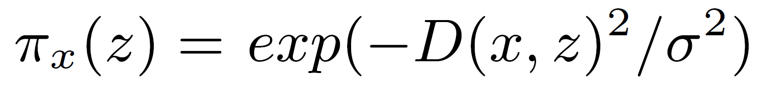
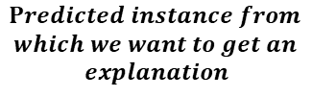
Introduction Machine learning Random forest Regression Explainable artificial intelligence Conclusions
LIME step by step
$$Predicted instance from$$
$$which we want to get an$$
$$explanation$$
Some distance function D
Kernel width

Slide 21
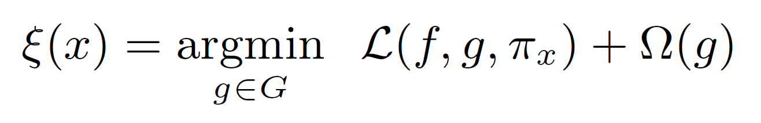
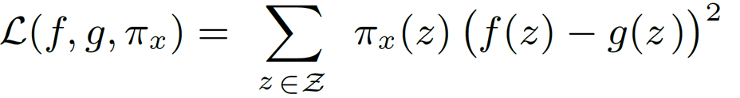
Introduction Machine learning Random forest Regression Explainable artificial intelligence Conclusions
Loss terms
Train a weighted, interpretable model on the dataset with the perturbed instances
(1)
Complex model
prediction
Simple model
prediction
(2)
?
LIME uses sparse linear models (K - LASSO)

Slide 22
Introduction Machine learning Random forest Regression Explainable artificial intelligence Conclusions
LIME limitations
Neighbourhood
Non-linearity
Improbable instances
Instability

Slide 23
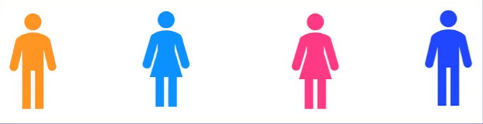

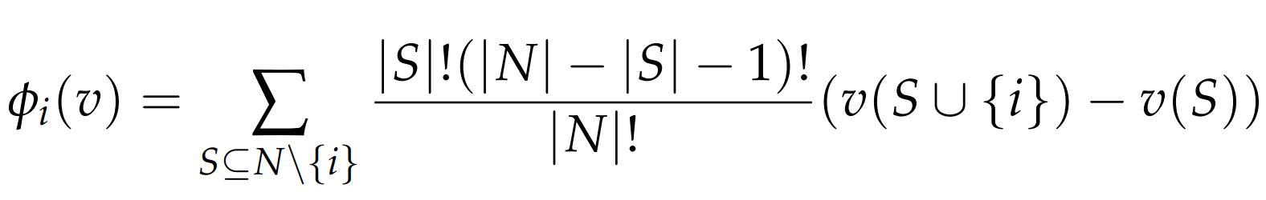

Introduction Machine learning Random forest Regression Explainable artificial intelligence Conclusions
Shapley values
Team
What is a fair distribution?
SHAPLEY VALUES
Lloyd Shapley
(1951)
Contribution
CODING COMPETITION
PAYOUT
$

Slide 24
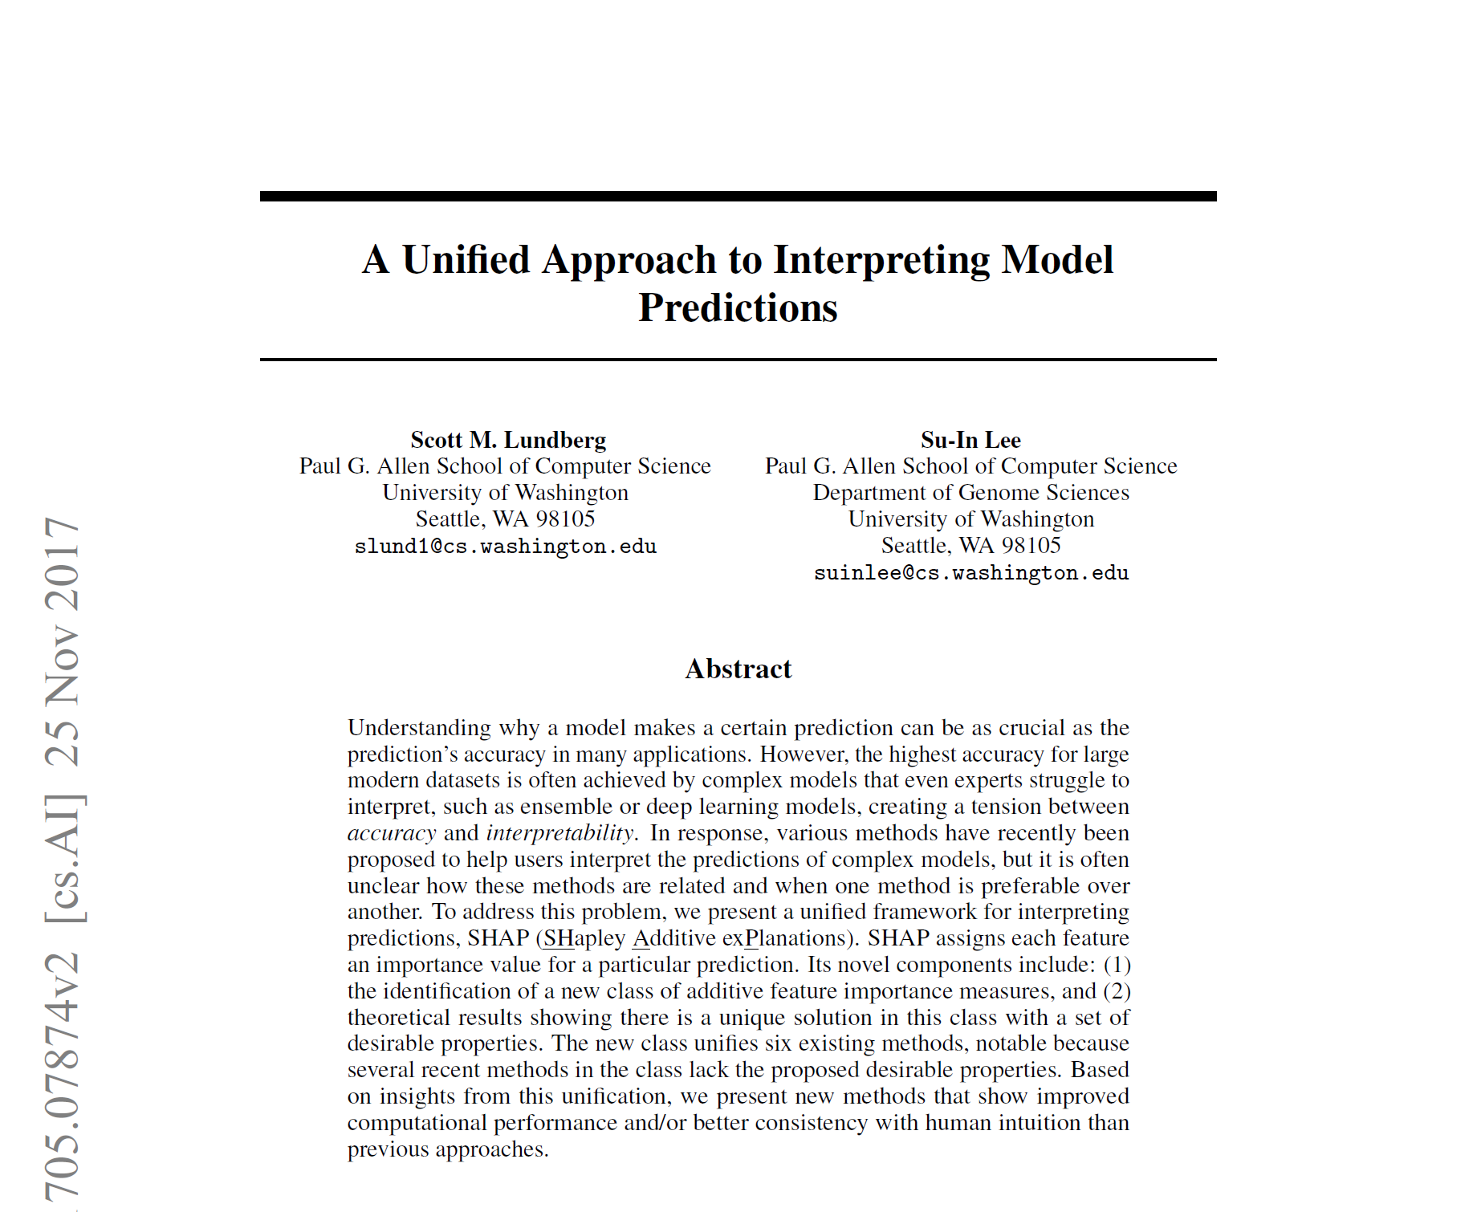

Introduction Machine learning Random forest Regression Explainable artificial intelligence Conclusions
SHAP
SHappley
Additive
exPlanations

Slide 25



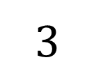


Introduction Machine learning Random forest Regression Explainable artificial intelligence Conclusions
Explainable Artificial Intelligence for Diabetes Prediction
SHAP
$$1$$
$$2$$
$$3$$
$$4$$
C
V
Aleix Nieto Juscafresa
An introduction to XAI with LIME and SHAP

Slide 26
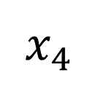
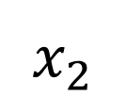
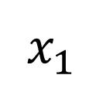
Introduction Machine learning Random forest Regression Explainable artificial intelligence Conclusions
Explainable Artificial Intelligence for Diabetes Prediction
SHAP
$$x_{1}$$
$$x_{2}$$
$$x_{4}$$
$$x_{4}$$
x
f(x)
Aleix Nieto Juscafresa
An introduction to XAI with LIME and SHAP

Slide 27
Introduction Machine learning Random forest Regression Explainable artificial intelligence Conclusions
SHAP
SHappley
Additive
exPlanations

Slide 28
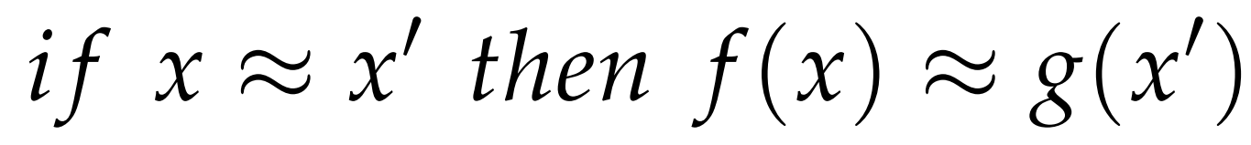
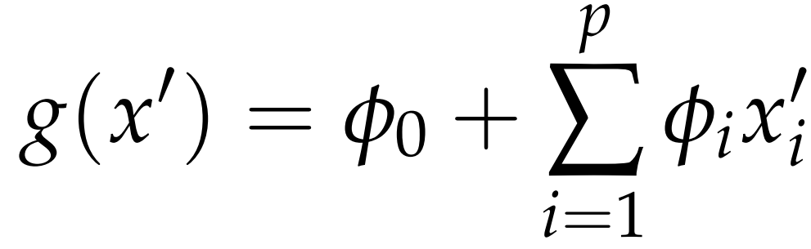
Introduction Machine learning Random forest Regression Explainable artificial intelligence Conclusions
Additive feature attribution methods

Slide 29
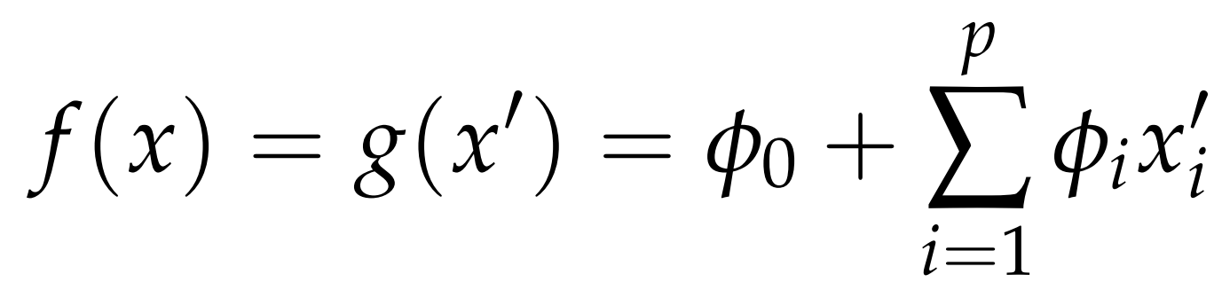
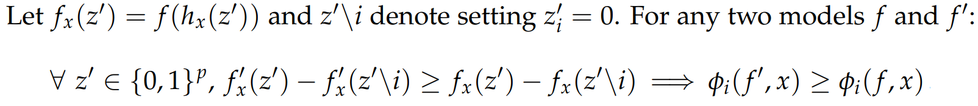
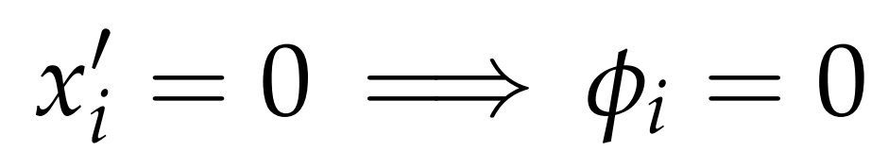
Introduction Machine learning Random forest Regression Explainable artificial intelligence Conclusions
Additive feature attribution methods properties
Properties
Local accuracy
Consistency
Missingness

Slide 30
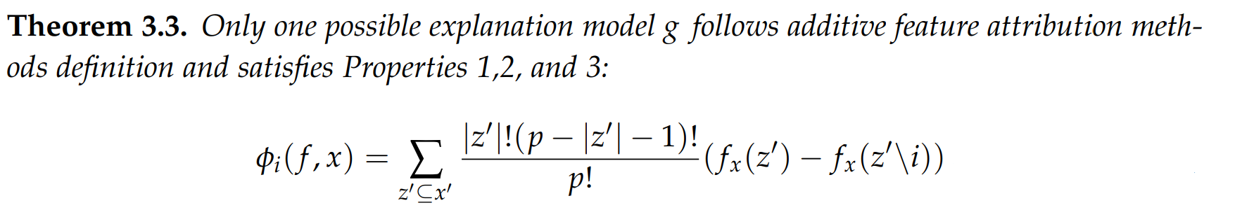
Introduction Machine learning Random forest Regression Explainable artificial intelligence Conclusions
Attribution methos satisfying properties 1, 2, 3

Slide 31
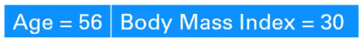




Introduction Machine learning Random forest Regression Explainable artificial intelligence Conclusions
Explainable Artificial Intelligence for Diabetes Prediction
Calculating Shapley values
Black Box model
Input data point
10% stroke
AGE
70% stroke
Shapley value
for feature i
Simplified data input
Weighting
Contribution
Subset
$$Age = 56$$ | $$Gender = F$$ | $$BMI = 30$$ | $$Stroke = yes$$ | $$…$$
$$Age = 56$$ | $$Gender = F$$ | $$BMI = 30$$ | $$Stroke = yes$$ | $$…$$
Aleix Nieto Juscafresa
An introduction to XAI with LIME and SHAP

Slide 32

Introduction Machine learning Random forest Regression Explainable artificial intelligence Conclusions
Explainable Artificial Intelligence for Diabetes Prediction
Calculating Shapley values
$$Age = 56$$ | $$Gender = F$$ | $$BMI = 30$$ | $$Stroke = yes$$ | $$…$$
SUBSET
$$Age = 56$$ | $$Gender = F$$ | $$BMI = 30$$ | $$Stroke = yes$$ | $$…$$
?
Aleix Nieto Juscafresa
An introduction to XAI with LIME and SHAP

Slide 33

Introduction Machine learning Random forest Regression Explainable artificial intelligence Conclusions
Explainable Artificial Intelligence for Diabetes Prediction
Calculating Shapley values
$$Age = 56$$ | $$Gender = F$$ | $$BMI = 30$$ | $$Stroke = yes$$ | $$…$$
SUBSET
$$Age = 56$$ | $$Random$$ | $$BMI = 30$$ | $$Random$$ | $$…$$
Aleix Nieto Juscafresa
An introduction to XAI with LIME and SHAP

Slide 34
Introduction Machine learning Random forest Regression Explainable artificial intelligence Conclusions
Explainable Artificial Intelligence for Diabetes Prediction
Calculating Shapley values
Additive feature attribution methods
$$2^{n}=total number of subsets of a set of size n$$
Aleix Nieto Juscafresa
An introduction to XAI with LIME and SHAP

Slide 35
Introduction Machine learning Random forest Regression Explainable artificial intelligence Conclusions
Explainable Artificial Intelligence for Diabetes Prediction
Calculating Shapley values
Additive feature attribution methods
$$2^{n}=total number of subsets of a set of size n$$
$$4 features: 64 total coalitions to sample$$
Aleix Nieto Juscafresa
An introduction to XAI with LIME and SHAP

Slide 36

Introduction Machine learning Random forest Regression Explainable artificial intelligence Conclusions
Explainable Artificial Intelligence for Diabetes Prediction
Calculating Shapley values
Additive feature attribution methods
$$2^{n}=total number of subsets of a set of size n$$
$$4 features: 64 total coalitions to sample$$
$$32 features: 17.1 billion$$
Aleix Nieto Juscafresa
An introduction to XAI with LIME and SHAP

Slide 37
Introduction Machine learning Random forest Regression Explainable artificial intelligence Conclusions
Explainable Artificial Intelligence for Diabetes Prediction
Shapley kernel
Shapley kernel
Aleix Nieto Juscafresa
An introduction to XAI with LIME and SHAP

Slide 38

Introduction Machine learning Random forest Regression Explainable artificial intelligence Conclusions
Explainable Artificial Intelligence for Diabetes Prediction
Shapley kernel theorem
Kernel SHAP = LIME + SHAPLEY VALUES
Aleix Nieto Juscafresa
An introduction to XAI with LIME and SHAP

Slide 39
Introduction Machine learning Random forest Regression Explainable artificial intelligence Conclusions
SHAP limitations
Computational cost
Access to data
Feature dependencies

Slide 40
Introduction Machine learning Random forest Regression Explainable artificial intelligence Conclusions
LIME and SHAP application
Diabetes public tabular database
Random forest fit with this database
LIME and SHAP explanations
Step by step

Slide 41

Introduction Machine learning Random forest Regression Explainable artificial intelligence Conclusions
LIME explanation

Slide 42

Introduction Machine learning Random forest Regression Explainable artificial intelligence Conclusions
SHAP explanation

Slide 43
Contents
Introduction
Machine learning
Random forest
Regression
Explainable artificial intelligence
Conclusions
Notes:
1 - First, let’s begin with the contents of the Project, which starts with an introduction.
2- Secondly I am going to explain….
3- then 3 & 4
4- In the fifth and the cornerstone section of the Project I introduce ….
5- Finallly a conclusion….

Slide 44

Introduction Machine learning Random forest Regression Explainable artificial intelligence Conclusions
Conclusion: LIME vs SHAP

Slide 45
Introduction Machine learning Random forest Regression Explainable artificial intelligence Conclusions
Conclusion: Summary
Detailed insight into the theory behind random forest
Formalise and unify the theory behind LIME and SHAP
Healthcare application for LIME and SHAP

Slide 46
Introduction Machine learning Random forest Regression Explainable artificial intelligence Conclusions
Future work
See how LIME explanations vary depending on the kernel width
Expand LIME and SHAP theory and application to images
Compare LIME and SHAP explanations

